Slide 1
Research Proposal Presentation
Research Methods and Professional Practice
May 2024
Daisy Ipatzi Bello

Slide 2

Contents
Project Title.
Significance
Research Question.
Aims and Objectives.
Key literature
Methodology/Development strategy/Research Design.
Ethical considerations and risk assessment (as part of your ethical approval application).
Description of artefact(s) that will be created.
Timeline of proposed activities.
Appendix

Slide 3

1. Project Title
“Evaluating K-means Clustering for Customer Profiling in B2B Ecommerce”

Slide 4
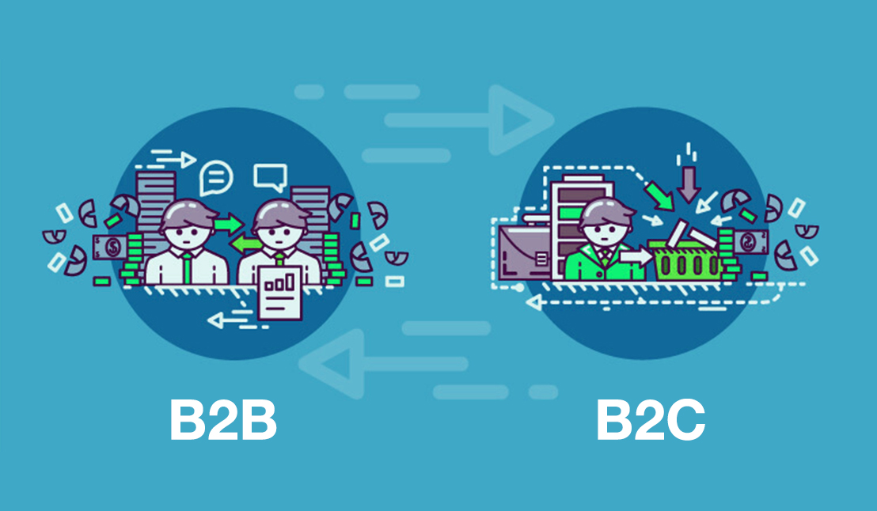
2. Significance
Importance of Customer Profiling
Challenges in B2B Customer Segmentation
Potential of K-means Clustering
Theoretical and Practical Contributions

Slide 5

3. Research Question
How effective is K-means clustering in segmenting B2B ecommerce customers based on purchasing behaviours and demographic characteristics?

Slide 6

4. Aims and Objectives.
Evaluate the effectiveness of K-means clustering in segmenting B2B ecommerce customers based on purchasing behaviours and demographic characteristics.
Identify the strengths and limitations of K-means clustering, explore its potential to improve targeted marketing strategies, and propose recommendations for optimising its use in the B2B ecommerce context.

Slide 7





5. Key literature

Slide 8
5. Key literature
Azevedo and Gartner (2020): Market Segmentation in Credit Markets
Borlea et al. (2021): Unified Fuzzy C-means and K-means Algorithms
Essayem et al. (2022): RFM Features and K-means Clustering
Mussabayev et al. (2022): Scalability of K-means for Big Data Clustering.
Nouraei et al. (2022): Comparative Analysis of Clustering Algorithms.
Zare and Emadi (2020): Customer Satisfaction Using Improved K-means.

Slide 9
6. Methodology
Research Design (Mixed Methods): Quantitative and qualitative data analysis.
Data Collection
Data Preprocessing
Feature Selection
Clustering Process
Validation and Evaluation
Data Analysis
Tools and Software
Scalability and Efficiency Considerations

Slide 10
7. Ethical considerations and risk assessment
Ethical Considerations
Data Privacy and Confidentiality
Informed Consent
Risk Assessment
Potential Risks
Data Security
Transparency and Accountability
Mitigation Strategies
Continuous Monitoring and Evaluation

Slide 11
8. Description of artefact(s) that will be created
Segmentation Model
Cluster Profiles
Visualization Dashboards
Recommendations
Technical Documentation

Slide 12
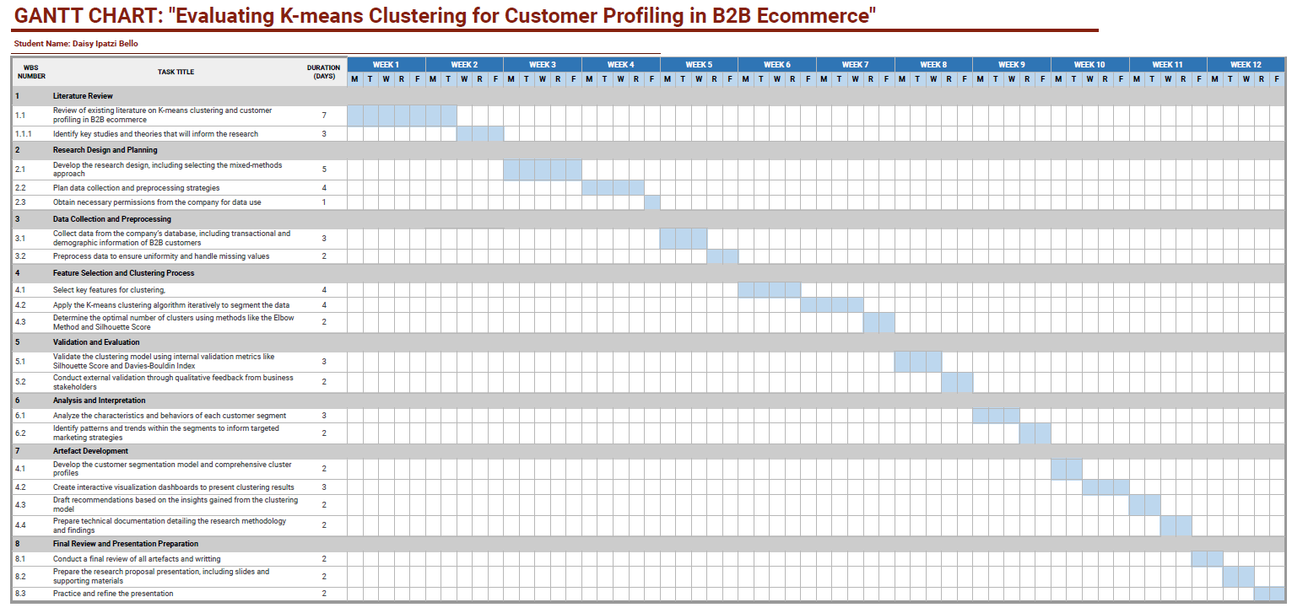
9. Timeline of proposed activities

Slide 13


Slide 14
References
Aarhus University (2022). IMRAD structure. [online] studypedia.au.dk. Available at: https://studypedia.au.dk/en/formal-requirements/imrad-structure [Accessed 27 Apr. 2024].
Azevedo, M. de A. and Gartner, I.R. (2020). Concentração e Competição no Mercado de Crédito Doméstico. Revista de Administração Contemporânea, [online] 24, pp.380–399. doi:https://doi.org/10.1590/1982-7849rac2020190347.
Borlea, I.-D., Precup, R.-E., Borlea, A.-B. and Iercan, D. (2021). A Unified Form of Fuzzy C-Means and K-Means algorithms and its Partitional Implementation. Knowledge-Based Systems, 214, p.106731. doi:https://doi.org/10.1016/j.knosys.2020.106731.
Essayem, W., Bachtiar, F.A. and Priharsari, D. (2022). Customer Clustering Based on RFM Features Using K-Means Algorithm. [online] IEEE Xplore. doi:https://doi.org/10.1109/CyberneticsCom55287.2022.9865572.
Golash-Boza, T. (2022). How to Write a Literature Review: Six Steps to Get You from Start to Finish. [online] www.wiley.com. Available at: https://www.wiley.com/en-us/network/publishing/research-publishing/writing-and-conducting-research/writing-a-literature-review-six-steps-to-get-you-from-start-to-finish [Accessed 2 Apr. 2024].
Govender, P. and Sivakumar, V. (2020). Application of k-means and hierarchical clustering techniques for analysis of air pollution: A review (1980–2019). Atmospheric Pollution Research, 11(1), pp.40–56. doi:https://doi.org/10.1016/j.apr.2019.09.009.
Huang, S., Kang, Z., Xu, Z. and Liu, Q. (2021). Robust deep k-means: An effective and simple method for data clustering. Pattern Recognition, 117, p.107996. doi:https://doi.org/10.1016/j.patcog.2021.107996.
Kotler, P. and Armstrong, G. (2014). Principles of marketing. Upper Saddle River, N.J.: Pearson.
Li, Y., Chu, X., Tian, D., Feng, J. and Mu, W. (2021). Customer segmentation using K-means clustering and the adaptive particle swarm optimization algorithm. Applied Soft Computing, 113, p.107924. doi:https://doi.org/10.1016/j.asoc.2021.107924.
Lloyd, C. (2017). LITERATURE REVIEWS FOR SOCIOLOGY SENIOR THESES. [online] Available at: https://socthesis.fas.harvard.edu/files/socseniorthesis/files/pres-litreview.pdf [Accessed 2 Apr. 2024].
Percentage of males on the sample is 45.7% and 54.3% for females.
Sample Size: 10,617 individuals
Total answers for whether drink nowadays: 8,534
Percentage of people who drink alcohol is 78.65%, the majority.

Slide 15
References
Mensouri, D., Azmani, A. and Azmani, M. (2022). K-Means Customers Clustering by their RFMT and Score Satisfaction Analysis. International Journal of Advanced Computer Science and Applications, 13(6). doi:https://doi.org/10.14569/ijacsa.2022.0130658.
Moshkovitz, M., Dasgupta, S., Rashtchian, C. and Frost, N., 2020, November. Explainable k-means and k-medians clustering. In International conference on machine learning (pp. 7055-7065). PMLR. mlr.press
Mussabayev, R., Mladenovic, N., Jarboui, B. and Mussabayev, R. (2022). How to Use K-means for Big Data Clustering? Pattern Recognition, p.109269. doi:https://doi.org/10.1016/j.patcog.2022.109269.
Nedyalkova, M., Madurga, S. and Simeonov, V. (2021). Combinatorial K-Means Clustering as a Machine Learning Tool Applied to Diabetes Mellitus Type 2. International Journal of Environmental Research and Public Health, 18(4), p.1919. doi:https://doi.org/10.3390/ijerph18041919.
Nouraei, H., Nouraei, H. and Rabkin, S.W. (2022). Comparison of Unsupervised Machine Learning Approaches for Cluster Analysis to Define Subgroups of Heart Failure with Preserved Ejection Fraction with Different Outcomes. Bioengineering, 9(4), p.175. doi:https://doi.org/10.3390/bioengineering9040175.
Peppers, D. and Rogers, M. (2010). Managing Customer Relationships. John Wiley & Sons.
Practical Data Science (2021). A quick guide to customer segmentation for B2B e-commerce. [online] practicaldatascience.co.uk. Available at: https://practicaldatascience.co.uk/data-science/a-quick-guide-to-customer-segmentation-for-b2b-e-commerce#google_vignette [Accessed 27 Apr. 2024].
Sembiring Brahmana, R.W., Mohammed, F.A. and Chairuang, K. (2020). Customer Segmentation Based on RFM Model Using K-Means, K-Medoids, and DBSCAN Methods. Lontar Komputer : Jurnal Ilmiah Teknologi Informasi, 11(1), p.32. doi:https://doi.org/10.24843/lkjiti.2020.v11.i01.p04.
Srivastava, S., Giri Gundu Hallur and Mukitm, A. (2023). Advanced-data analytics in telecommunications industry: A case study of accenture. Nucleation and Atmospheric Aerosols. [online] doi:https://doi.org/10.1063/5.0170732.
Vohra, R., Pahareeya, J., Hussain, A., Ghali, F. and Lui, A. (2020). Using Self Organizing Maps and K Means Clustering Based on RFM Model for Customer Segmentation in the Online Retail Business. Intelligent Computing Methodologies, pp.484–497. doi:https://doi.org/10.1007/978-3-030-60796-8_42.
Xiaoyu, Z. (2023). Exploring the Efficacy of Adaptive Learning Technologies in Online Education: A Longitudinal Analysis of Student Engagement and Performance. International Journal of Science and Engineering Applications. [online] doi:https://doi.org/10.7753/ijsea1212.1007.
Zare, H. and Emadi, S. (2020). Determination of Customer Satisfaction using Improved K-means algorithm. Soft Computing, 24(22), pp.16947–16965. doi:https://doi.org/10.1007/s00500-020-04988-4.
Percentage of males on the sample is 45.7% and 54.3% for females.
Sample Size: 10,617 individuals
Total answers for whether drink nowadays: 8,534
Percentage of people who drink alcohol is 78.65%, the majority.

